Slide 1

Parkinson’s Disease Detection Using Machine Learning

Slide 2




Problem Statement & Motivation
Parkinson’s Disease (PD) is a progressive neurological disorder impacting millions globally. Early, subtle vocal changes (dysphonia) often precede motor symptoms, yet traditional diagnosis remains subjective and frequently delayed.
Progressive Disorder
Subtle Voice Markers
PD significantly impairs quality of life, necessitating early intervention.
Dysphonia is a key early indicator, often overlooked in routine check-ups.
Delayed Diagnosis
Our Goal
Current methods lead to missed opportunities for timely treatment.
Develop a non-invasive, ML-driven voice analysis tool for early detection.

Slide 3
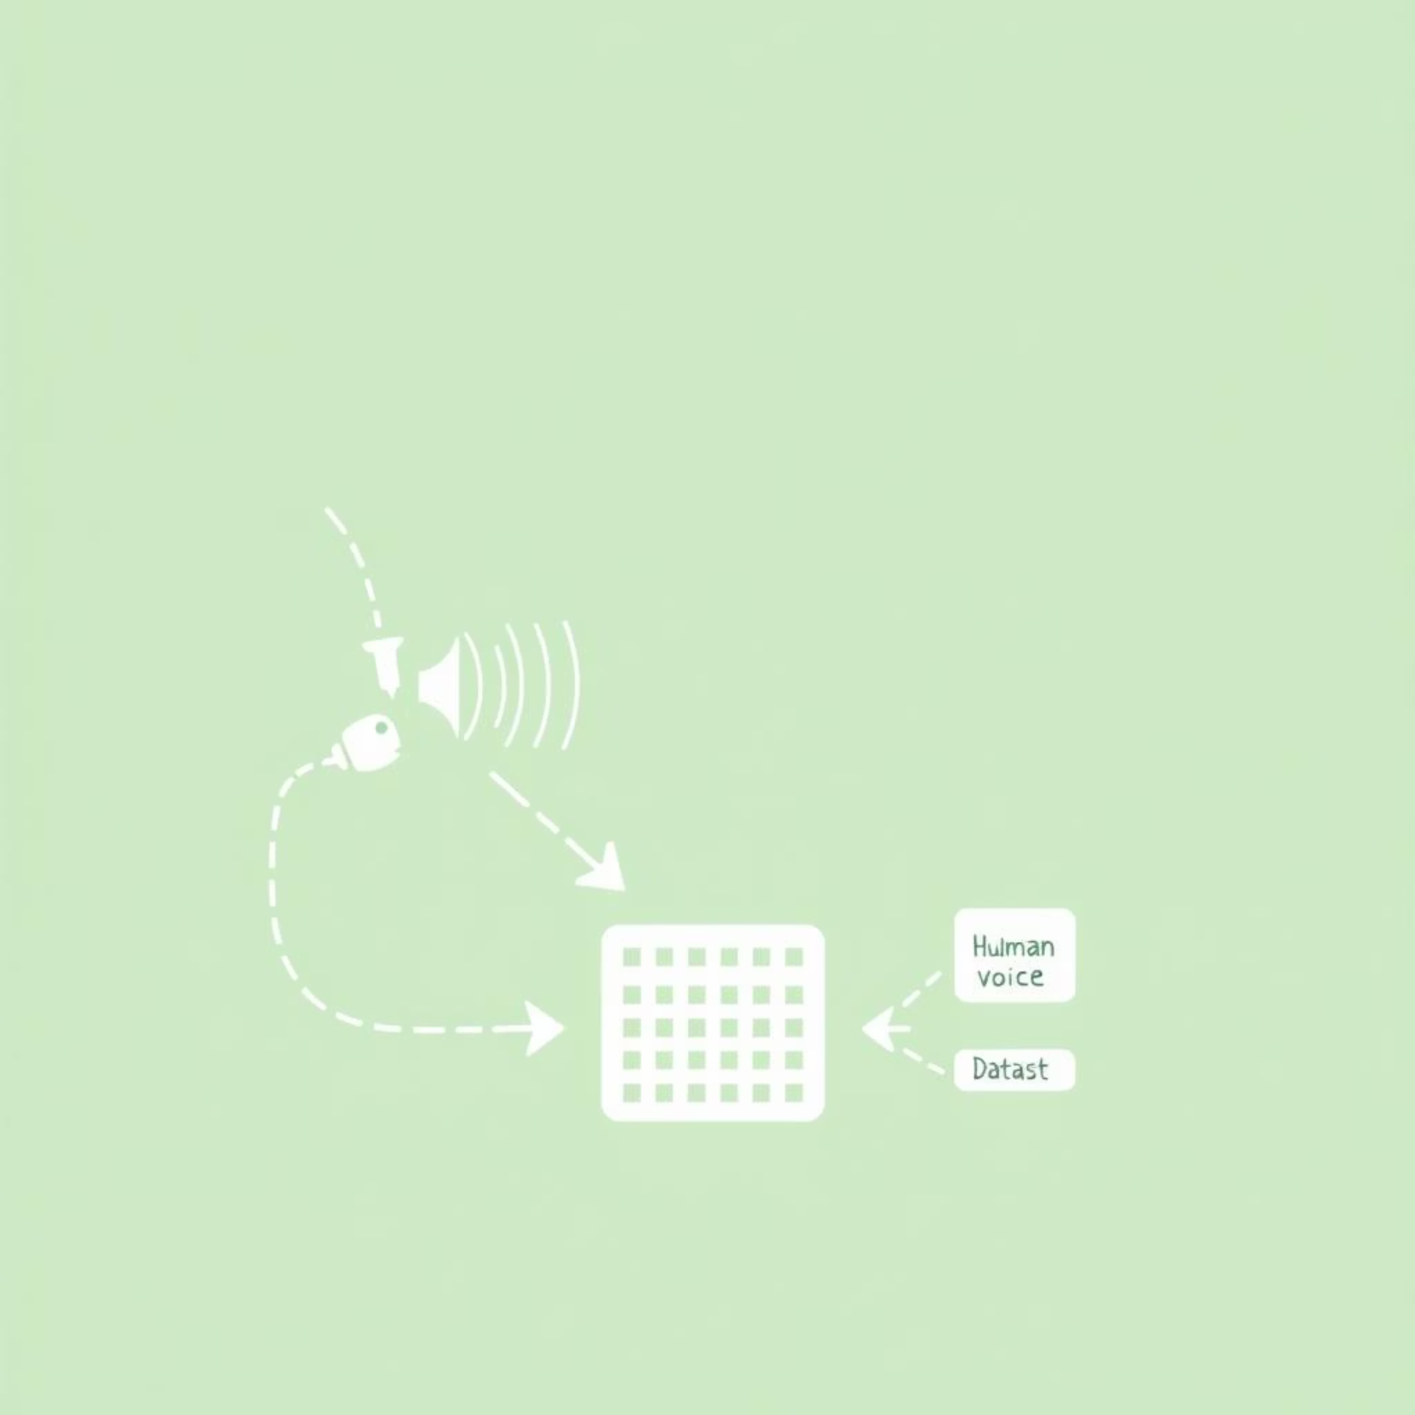
Dataset Overview: UCI Parkinson’s Voice Data
The study utilised the publicly available UCI Parkinson’s Dataset, a robust collection for voice-based PD analysis, curated by Oxford University.
Source: UCI Machine Learning Repository (Oxford University)
Recordings: 195 voice samples from 31 individuals
Features: 22 distinct acoustic features, including Jitter, Shimmer, Pitch Perturbation, and others, capturing vocal irregularities.
Target Variable: Binary status (0 = healthy, 1 = Parkinson’s).

Slide 4
Data Preprocessing Pipeline
Robust data preprocessing was crucial to ensure model performance and prevent biases.
Data Splitting
Feature Scaling
The dataset was partitioned into 80% training and 20% testing sets, ensuring an unbiased evaluation of the models' generalisation capabilities.
Feature Selection
StandardScaler was applied to normalise feature ranges, enhancing model convergence and performance, particularly for distance-based algorithms.
Irrelevant attributes, such as 'name', were systematically removed to streamline the dataset and prevent noise.

Slide 5






Machine Learning Models Employed
A diverse suite of supervised learning algorithms was rigorously evaluated to identify the optimal approach for Parkinson's disease detection.
Logistic Regression
Probabilistic classification for binary outcomes.
Decision Tree Classifier
Rule-based classification with interpretability.
Naive Bayes
Probabilistic classifier based on Bayes' theorem.
K-Nearest Neighbours (KNN)
Non-parametric, instance-based learning.
Support Vector Machine (SVM)
Maximising margin hyperplane for classification.
Random Forest
Ensemble method leveraging multiple decision trees.

Slide 6
Model Performance Evaluation
A comprehensive evaluation using key metrics revealed the superior performance of K-Nearest Neighbours (KNN) for this specific task.
KNN
89.7%
0.91
0.96
0.94
SVM / LR / RF
~87%
~0.88
~0.96
~0.92
Naive Bayes
74.4%
0.91
0.74
0.82
KNN excelled in Accuracy and Recall, making it highly suitable for early-stage screening where minimising false negatives is critical.
Models were chosen for their balance of performance and computational efficiency.

Slide 7
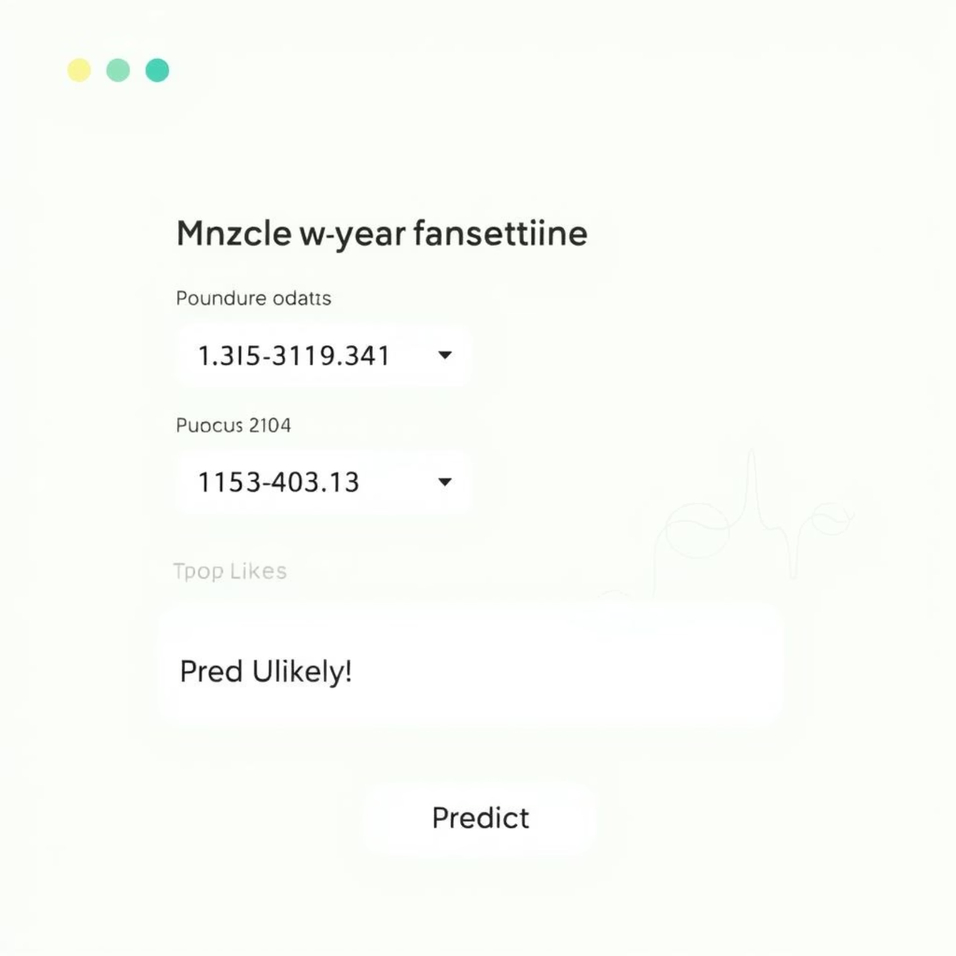
Flask Web Application for Real-Time Prediction
To demonstrate practical applicability, a user-friendly web interface was developed using Flask, a lightweight Python web framework.
Framework: Flask (Python)
Input: Users provide the 22 voice feature values via a simple web form.
Output: The application processes inputs using the trained KNN model and displays "PD Likely" or "PD Unlikely".
Interface: Designed for intuitive interaction, enabling non-technical users to access the predictive capability.

Slide 8




Key Project Outcomes & Achievements
This project successfully demonstrated the potential of ML in healthcare diagnostics and provided invaluable hands-on experience.
Optimal Model Identified
High Predictive Accuracy
KNN was empirically validated as the top-performing model, achieving nearly 90% accuracy.
Models consistently achieved an 85–90% accuracy range in detecting Parkinson's from voice data.
Functional Web Tool
Holistic ML Workflow
A real-time Flask web application was developed, bringing the model to life.
Gained comprehensive experience across data processing, model selection, and deployment.

Slide 9

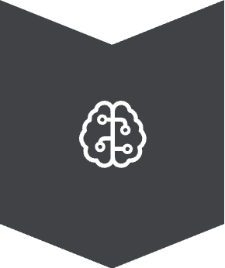


Future Scope & Potential Enhancements
Building upon this foundation, several avenues exist for further research and development.
Live Voice Input
Integrate real-time audio capture from browser microphones for immediate analysis.
Deep Learning Exploration
Apply CNNs/RNNs on raw audio or spectrograms for advanced feature extraction and higher accuracy.
Dataset Augmentation
Incorporate larger, more diverse datasets to improve model generalisation and robustness.
Clinical Validation
Collaborate with healthcare professionals for real-world testing and eventual clinical deployment.

Slide 10

Thank You
Questions?

